Slide 1
EVENT MANAGEMENT SYSTEM
Group Members:
Aqsa Naz (19B-033-SE)
Gul e Hasnain (19B-010-SE)
Asad Ali Najeeb (19B-047-SE)
Roha Rafaqat (19B-058-SE)
Muhammad Ahtisham (19B-045-SE)

Slide 2
Table of Contents
01
02
03
04
INTRODUCTION TO EMS
05
CONSTRAINTS
OBJECTIVE
06
LIST OF FIGURES
DEPENDENCIES / EXTERNAL
SYSTEM
07
IMPLEMENTATION
REQUIREMENTS
08
INTERFACES

Slide 3
01
INTRODUCTION TO EMS

Slide 4

EVENT MANAGEMENT SYSTEM
Event Management System is used to manage all the activities related to event. In any event many service providers works simultaneously, and it is hard to manage these providers. It is also important for event organizer that he has all the contact detail of the service providers so that he can manage the event properly. To manage all these activities we have developed this software

Slide 5
02
OBJECTIVE

Slide 6

System works very efficiently it stores, maintain and retrieve data from its database and can be easily use for further analysis. Event Managers keep record of all events and its details.

Slide 7
03
Dependencies / External System

Slide 8
DEPENDENCIES / EXTERNAL SYSTEM
Following are the tools / technologies on which our system depends for its completion:
Programming Language | Python
Front-end | Tkinter Python
Back-end | Cx_Oracle
Database | Oracle 12c
Tools | Pycharm

Slide 9
04
REQUIREMENTS

Slide 10
Requirements
FUNCTIONAL REQUIREMENTS
Registration.
To enter the system employee has to register first.
Requirements for registration are username, password and user id (provided by admin)
Employee Login.
The system provides facility to login into the system.
Enter user id and password.
If Authorize, then employee panel opens.
Admin Login.
The system provides facility to login into the system.
Enter user id and password.
If Authorize, then admin panel opens.

Slide 11
Requirements
FUNCTIONAL REQUIREMENTS
4. Admin Working.
After login into system admin can perform following task.
a. Employee ( Add , Update, Delete)
b. Venue ( Add, Update, Delete)
c. Food ( Add, Update, Delete)
d. Vendor ( Add, Update, Delete)
e. Decoration ( Add, Update, Delete)
f. Service ( Add, Update, Delete)

Slide 12
Requirements
FUNCTIONAL REQUIREMENTS
5. Employee Working.
After login into system employee can perform following task.
a. Book Event
b. View Venue
c. View Food
d. View Vendor
e. View Decoration
f. View Service
6. Employee Change Password.
Enter Current Password.
Provide New Password
Confirm New Password.

Slide 13
Requirements
FUNCTIONAL REQUIREMENTS
7. Logout.
The system provides the facility to logout from the system.
Input : Select Logout option
Output: Logout from the system
Processing: User will logout

Slide 14
Requirements
NON-FUNCTIONAL REQUIREMENTS
Performance.
The system need to be reliable.
If unable to process the request, then appropriate error message
Safety.
The detail need to be maintained properly.
User must be authenticated
The database must be kept backed up.
Security.
After entering user id and password the user can access his panel.
The details of users must be safe and secure

Slide 15
05
CONSTRAINTS

Slide 16
Constraints
The constraints are:
Only register employees will be able to book an event
Every employee have its own private user id and password

Slide 17
06
LIST OF FIGURES

Slide 18
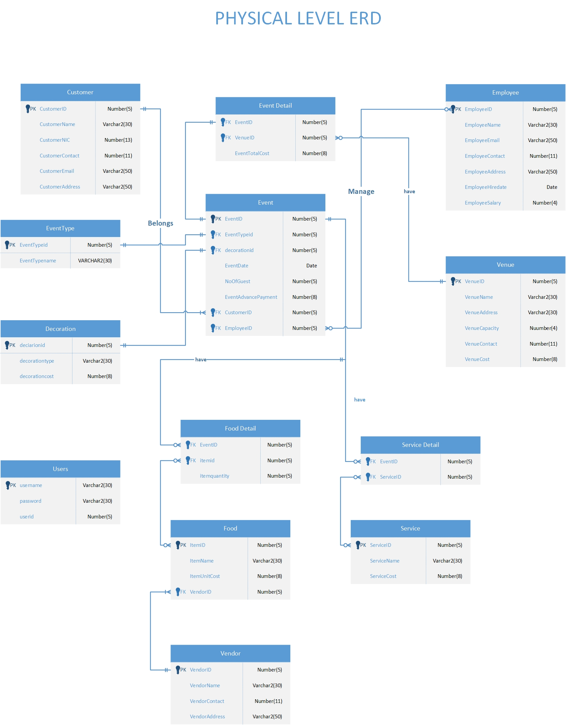
ENITITY RELATIONSHIP DIAGRAM

Slide 19
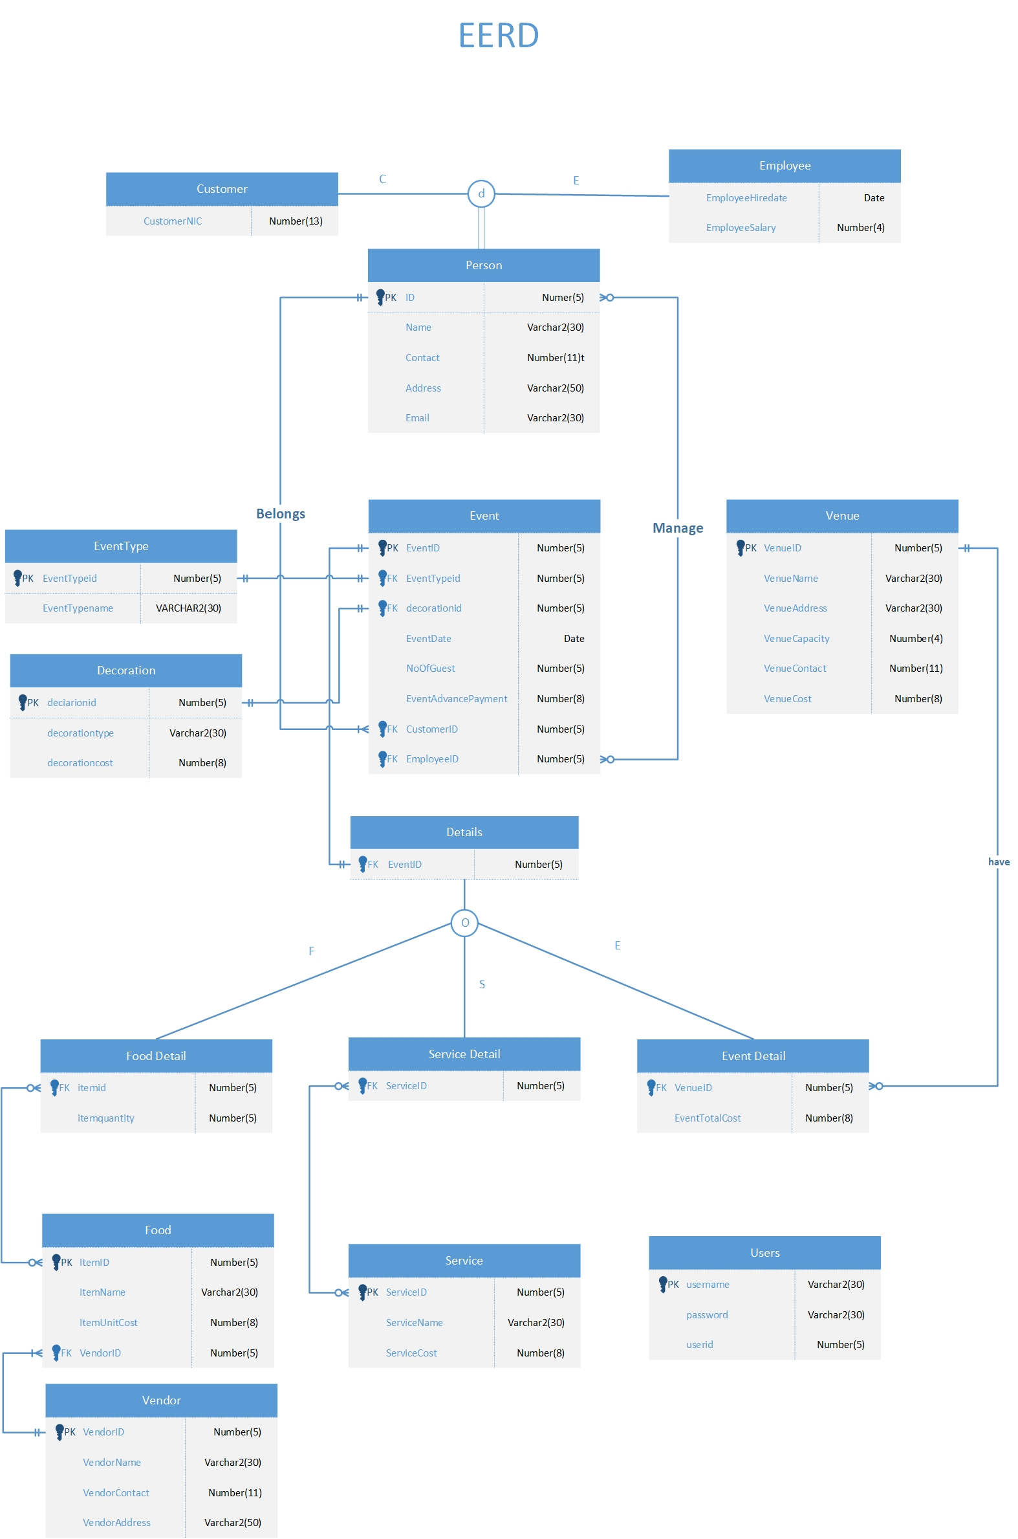
ENHANCED ENITITY RELATIONSHIP DIAGRAM

Slide 20
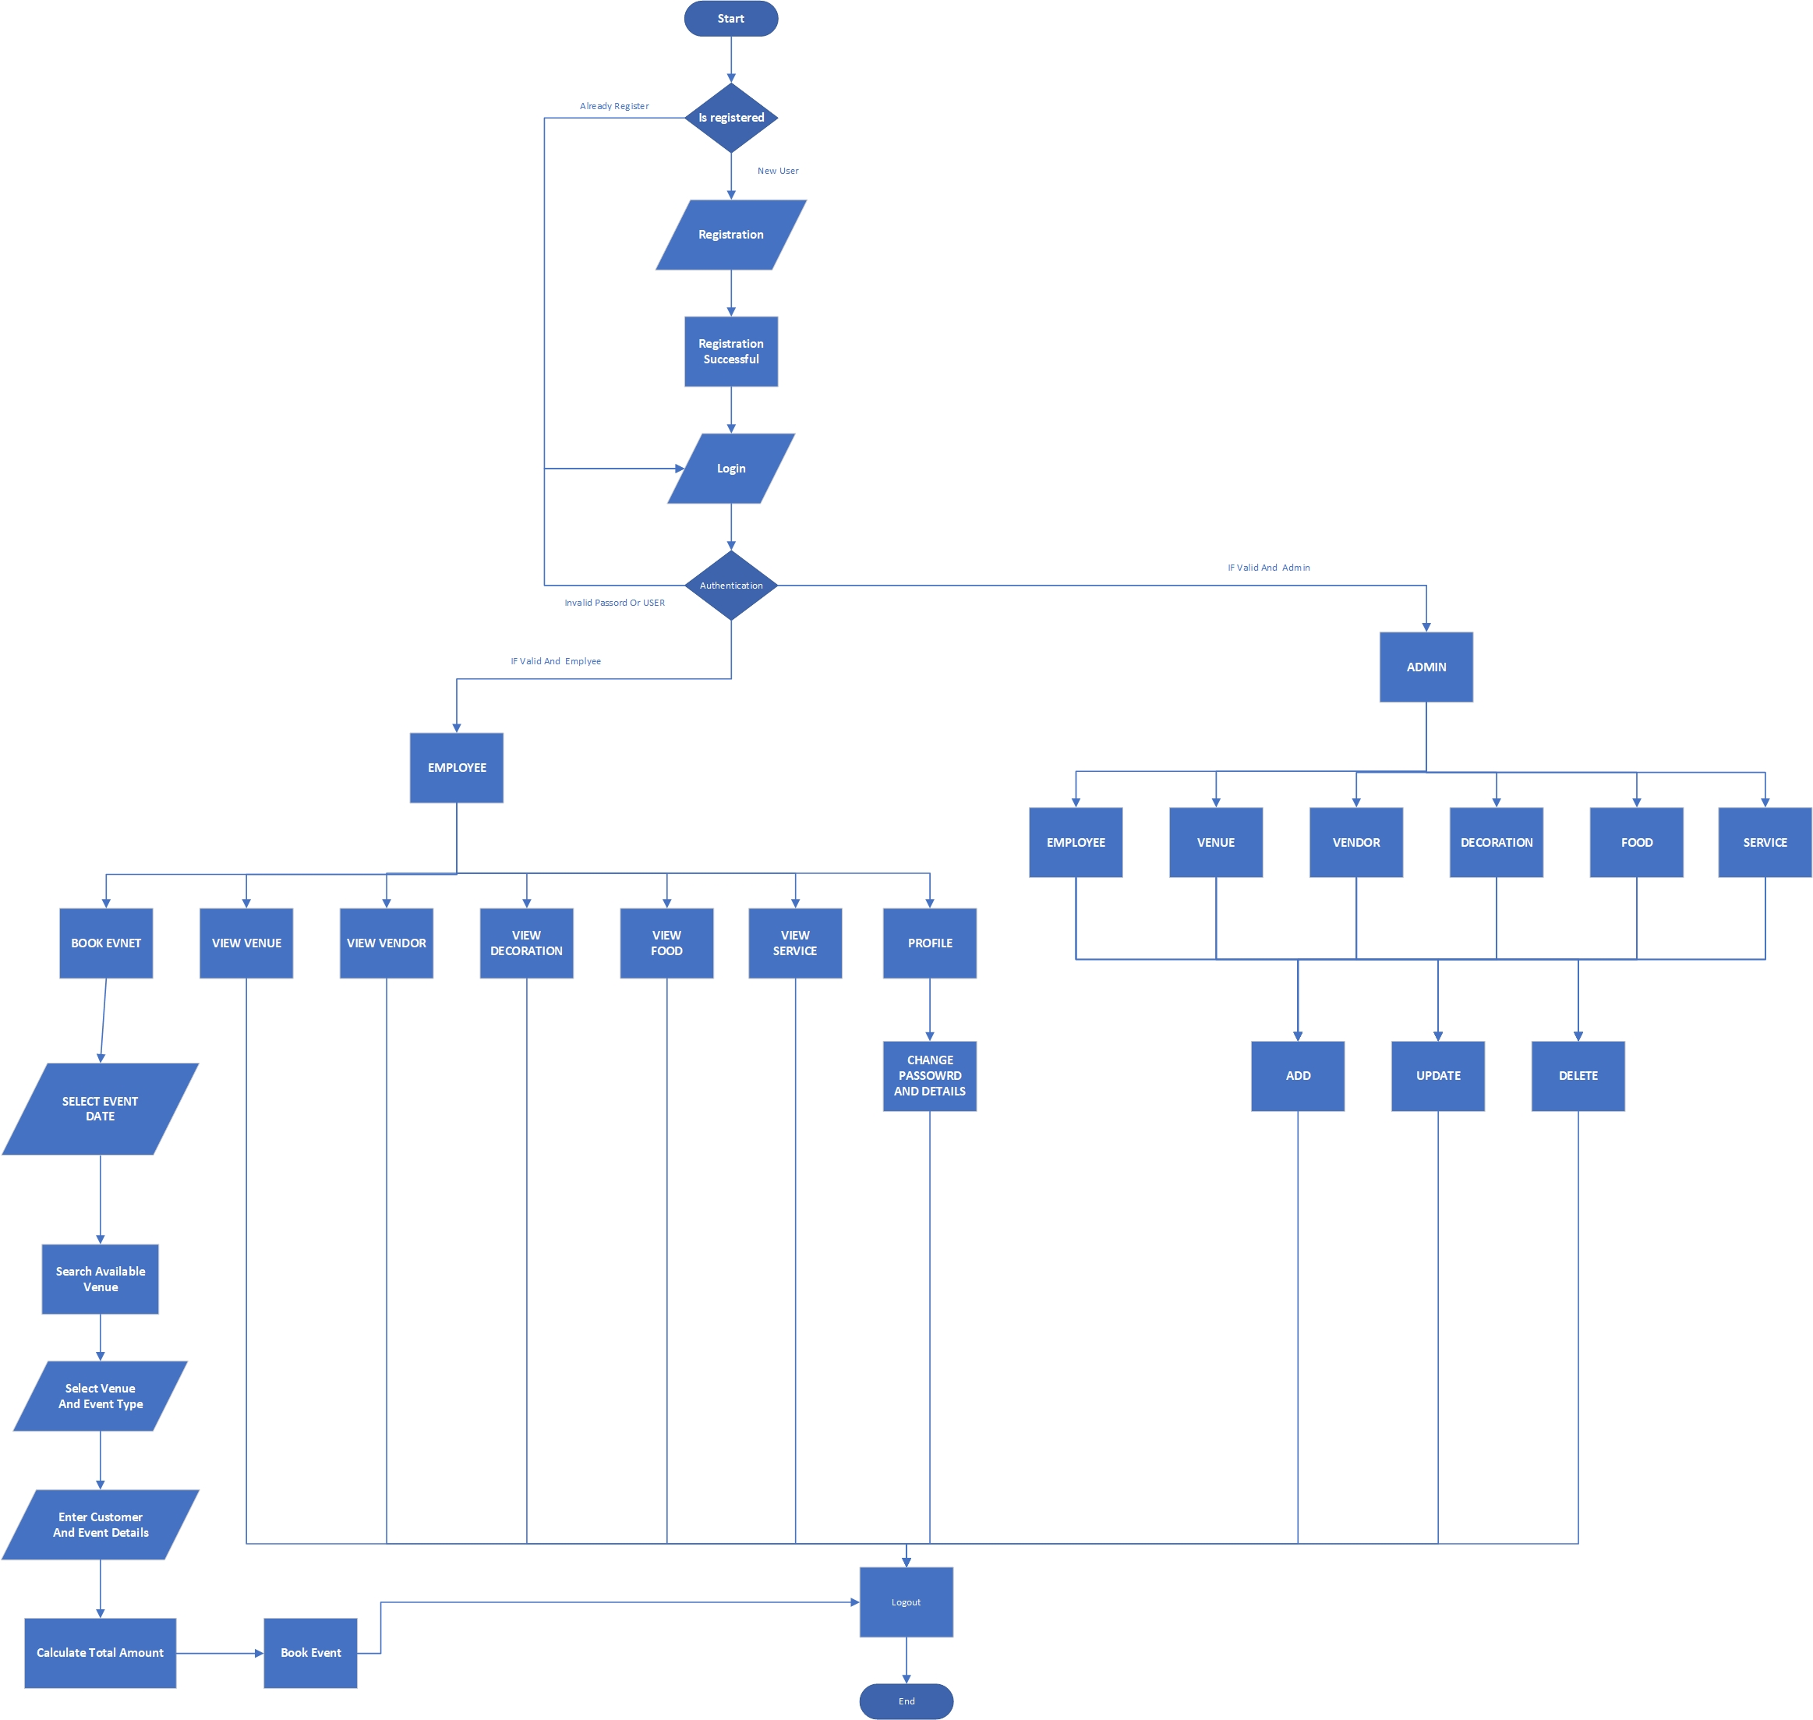
SYSTEM FLOW DIAGRAM

Slide 21
07
IMPLEMENTATION

Slide 22
08
INTERFACE

Slide 23
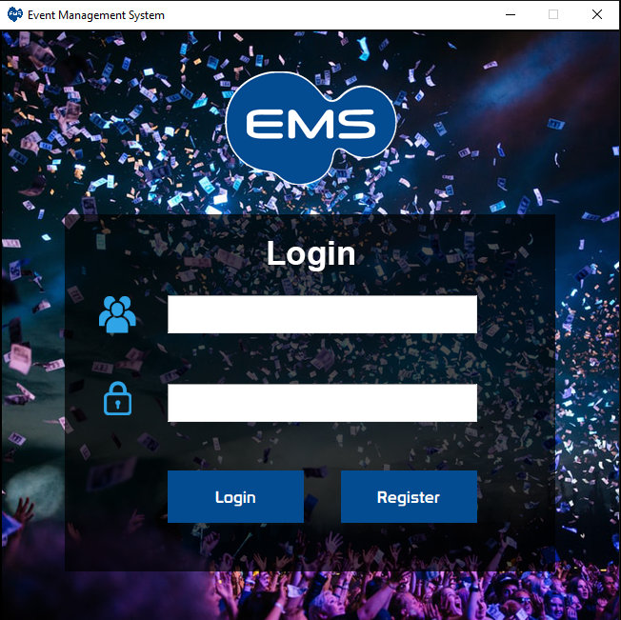
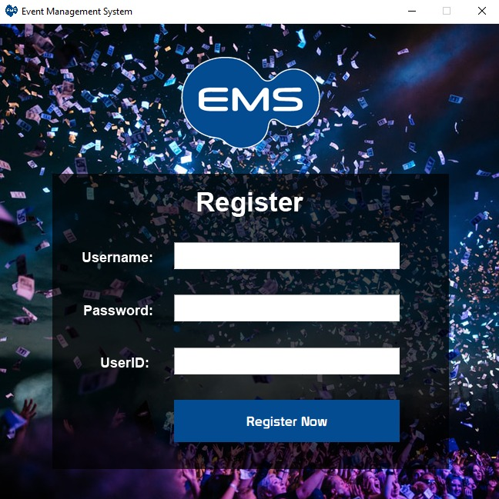
LOGIN / REGISTER

Slide 24
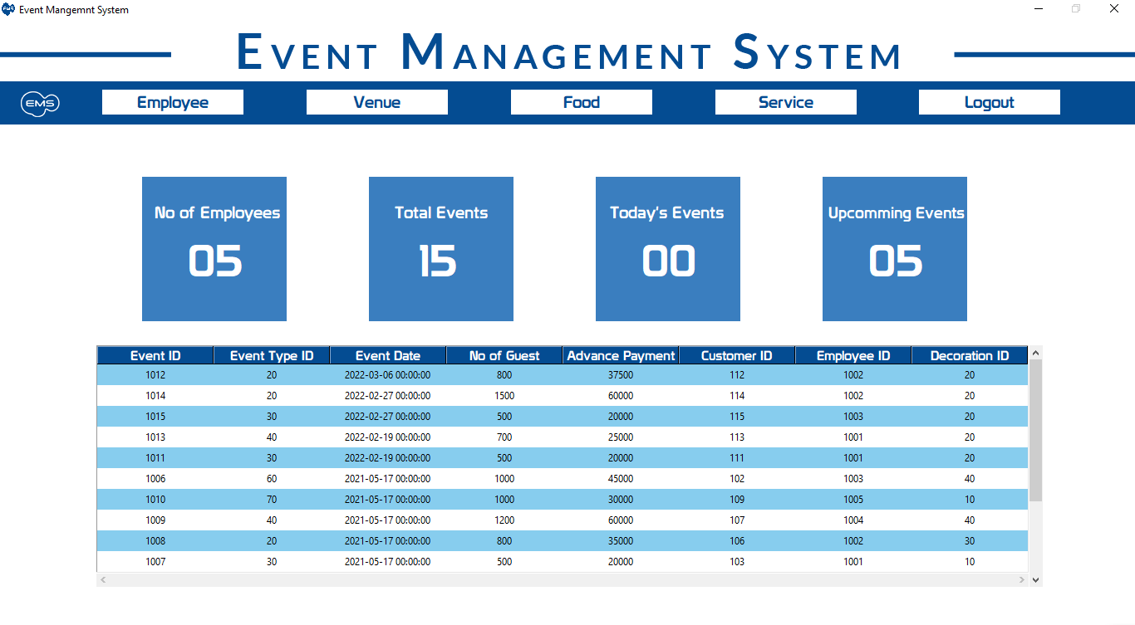
ADMIN HOME

Slide 25
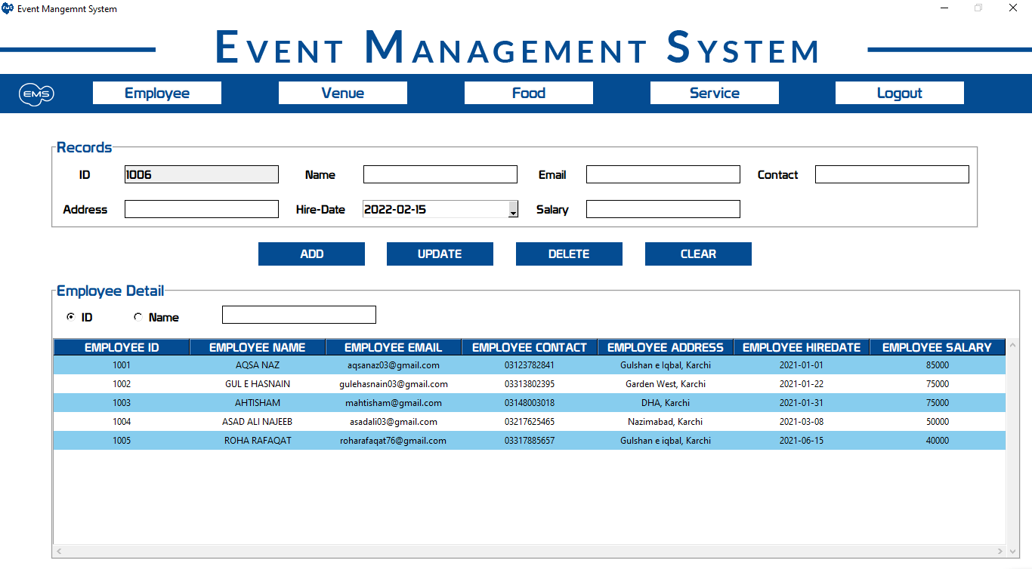
ADMIN EMPLOYEE

Slide 26
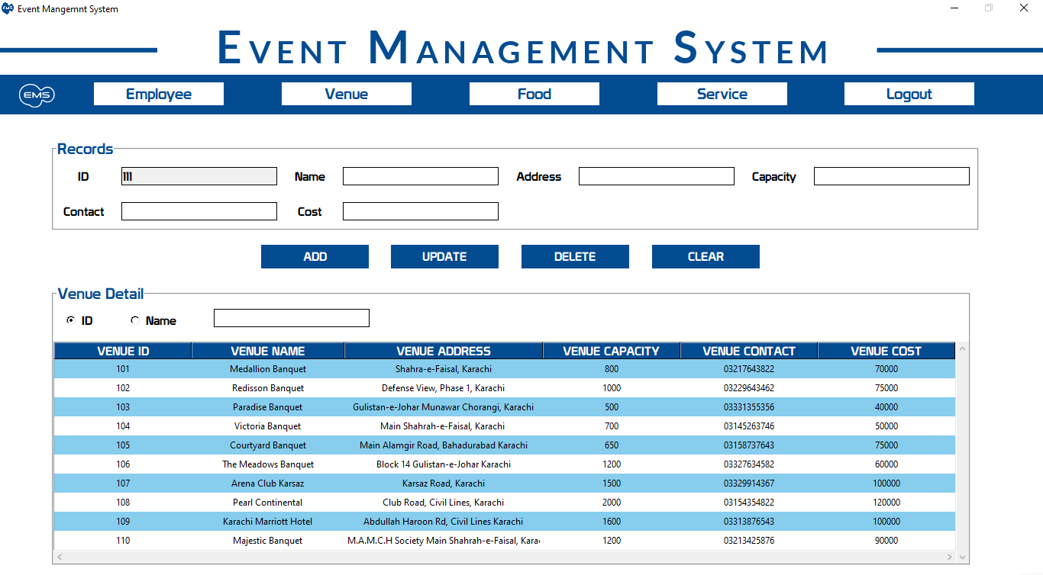
ADMIN VENUE

Slide 27
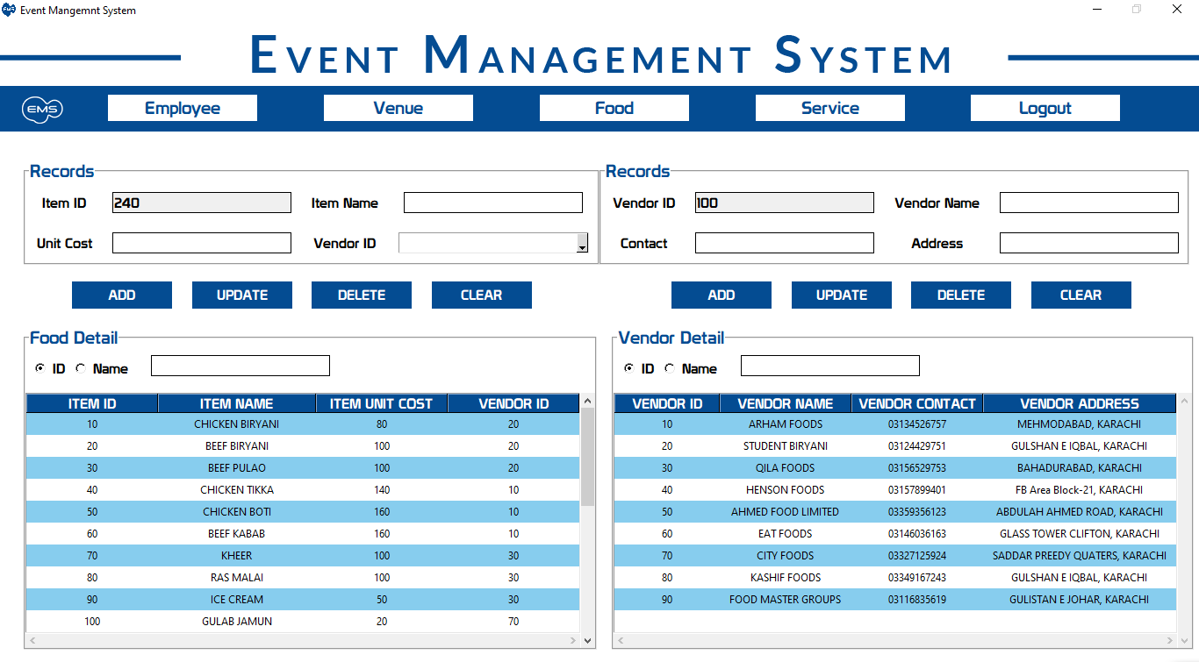
ADMIN FOOD & VENDOR

Slide 28
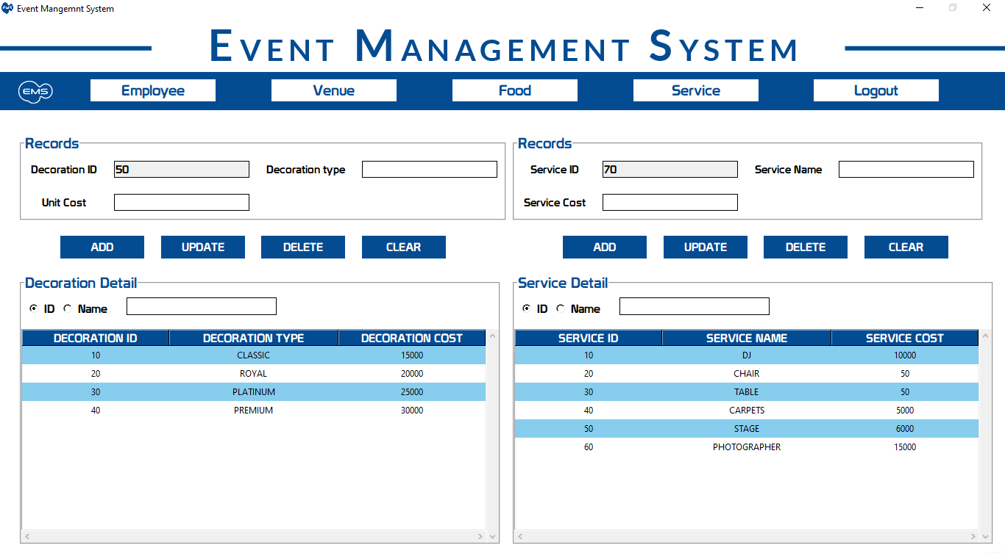
ADMIN SERVICE & DECORATION

Slide 29
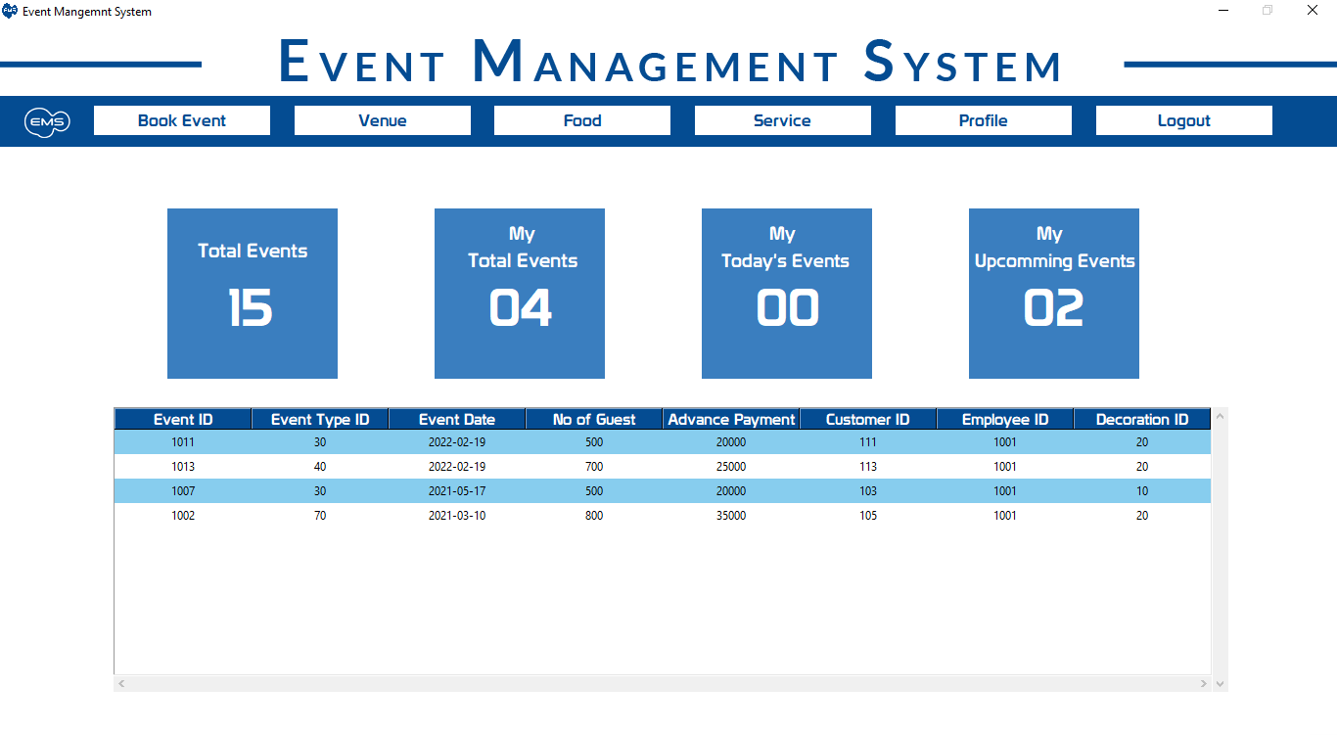
EMPLOYEE HOME

Slide 30
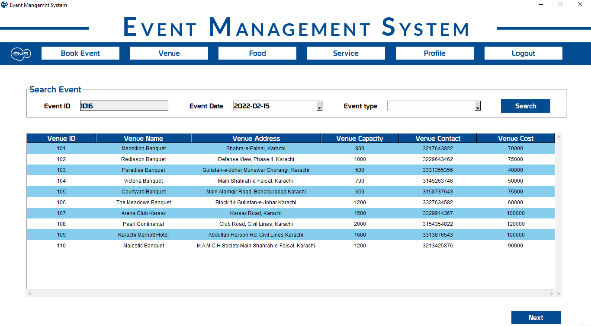
EMPLOYEE BOOK EVENT-1

Slide 31
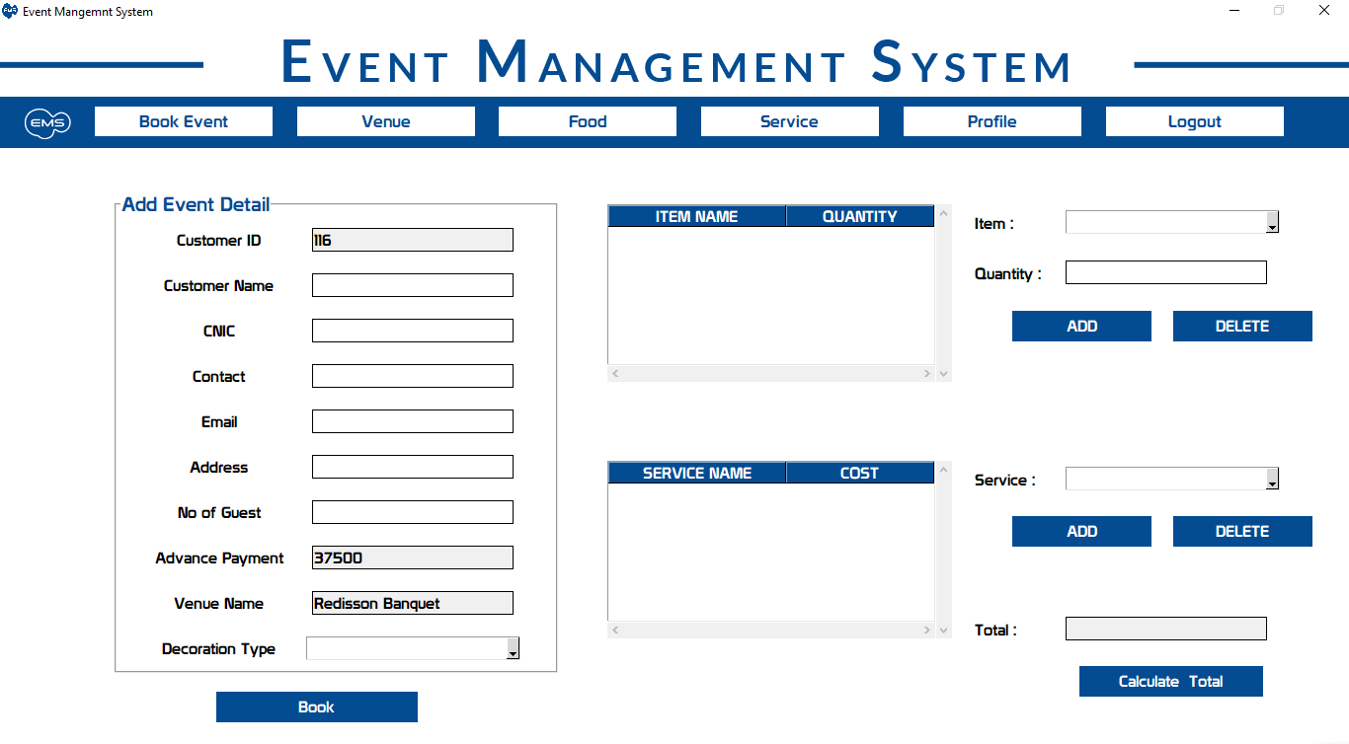
EMPLOYEE BOOK EVENT-2

Slide 32
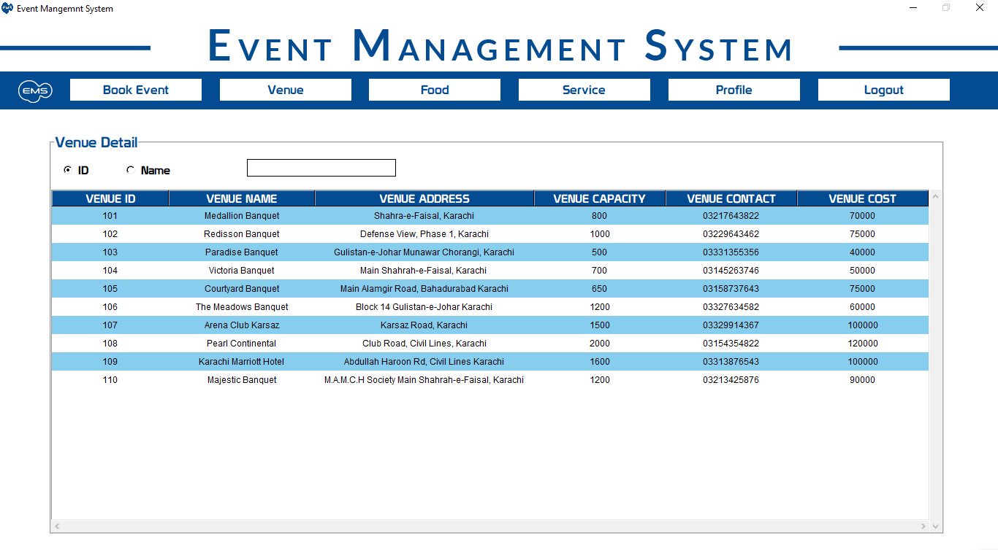
EMPLOYEE VENUE

Slide 33
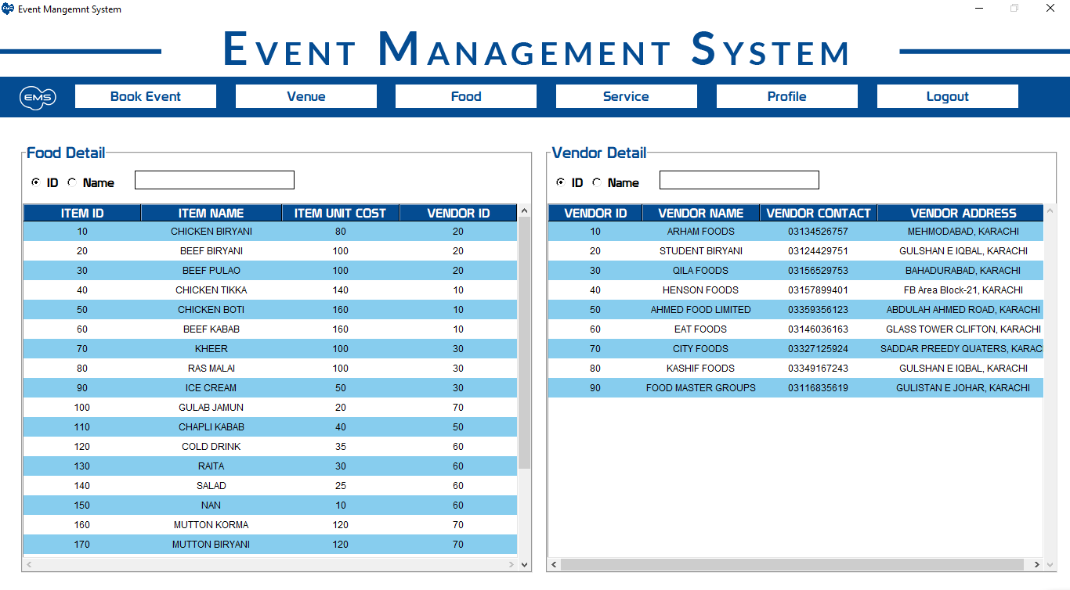
EMPLOYEE FOOD & VENDORS

Slide 34
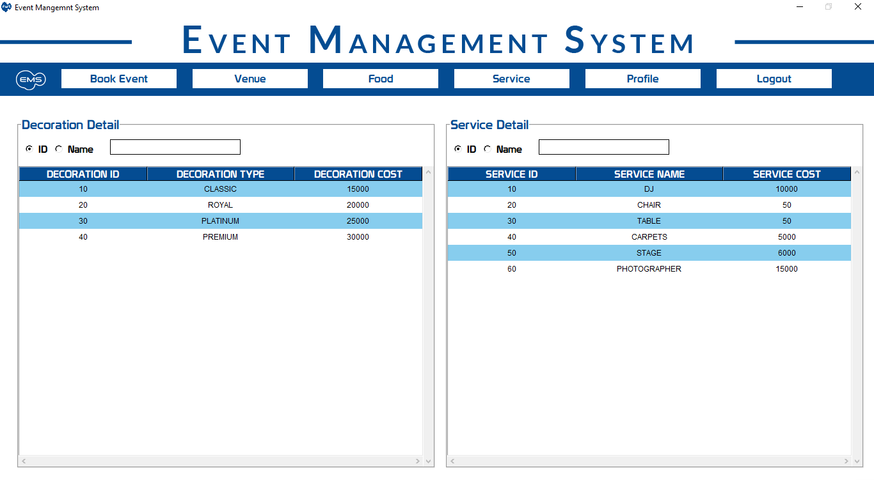
EMPLOYEE SERVICE & DECORATION

Slide 35
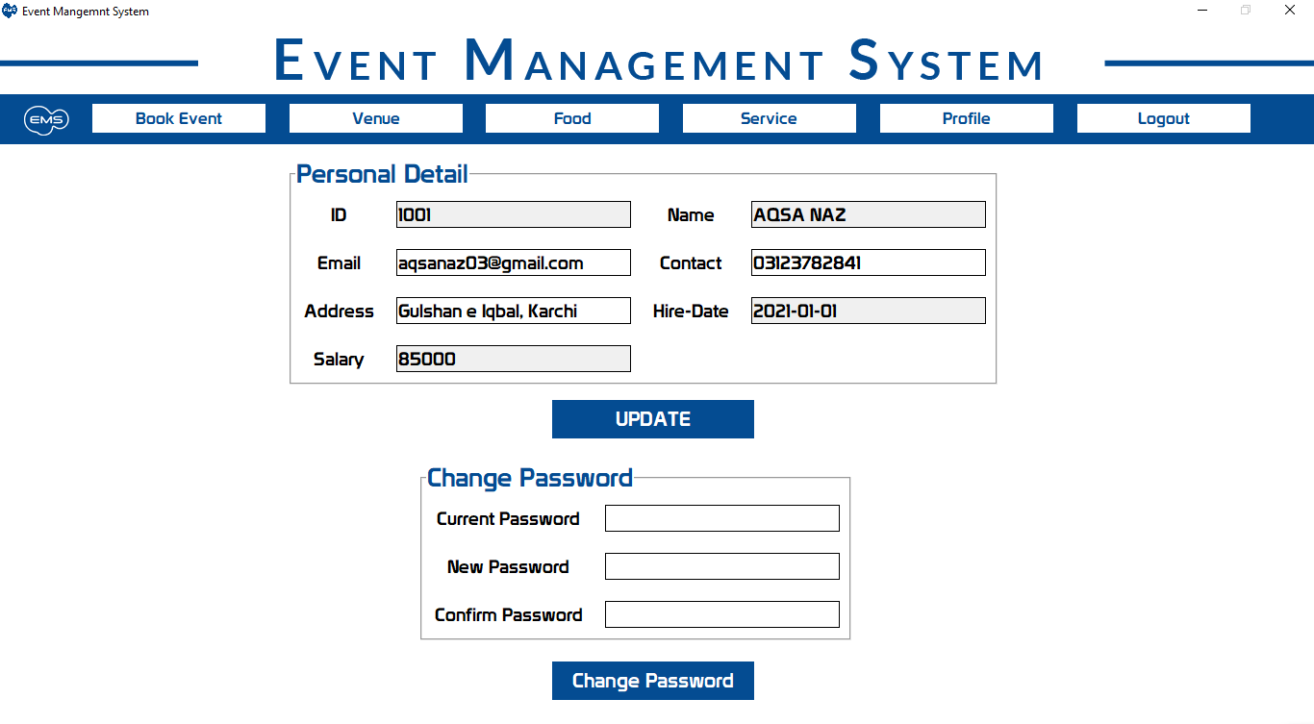
EMPLOYEE PROFILE

Slide 36
Thanks!

